Slide 1


GARDEN CITY university
DR. APJ ABDUL KALAM SCHOOL OF ENGINEERING

Slide 2

TOPIC NAME : PHOTOGRAPHY WEBSITE
PREPARED BY:
VISHAL
23BTIT167
GIT: Vishalpatil7483
4. JAYAPRAKASH
23BTIT120
GIT: Jayjp123
2. CHINMAY
23BTIT109
GIT: Chinmay3251
LIKITH MV
23BTIT127
GIT: likithmv
Paris
New York
3. SIDRAMAYYA 23BTIT153
GIT: sidramayyasiddu

Slide 3

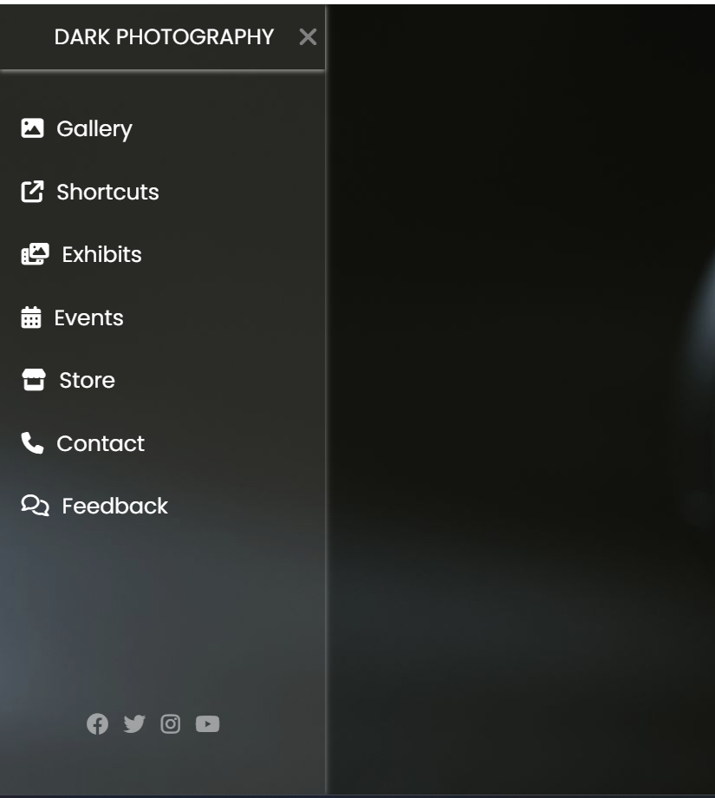
FEATURES OF WEBSITE
Click on hamburger icon to get option menu .
It consists of following buttons or options
1.Gallery
2.Shortcuts
3.Exhibits
4.Events
5.Store
6.Contact
7.Feedback
8.Social media links

Slide 4

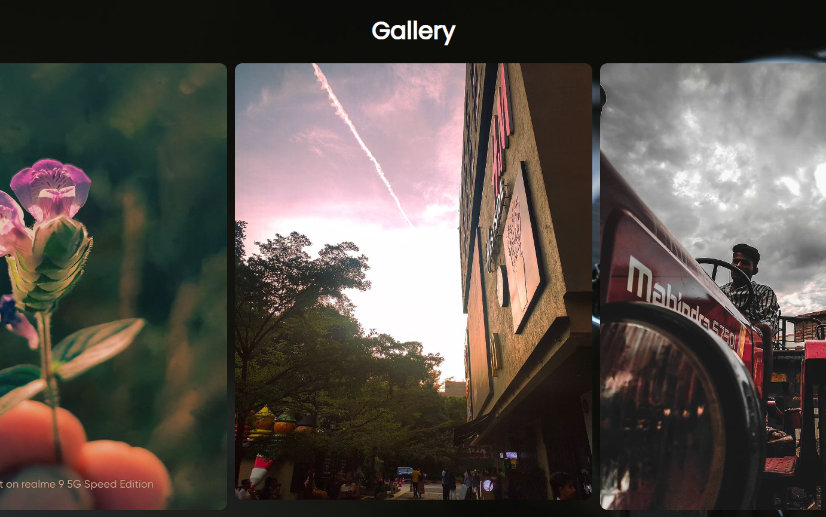
GALLery
Here we can store Pics of our collections
By this we can showcase our works to others
If we hover on image , slowly size increases , It gives smooth effect to the page
We created a separate page called “Gallery” and linked it to main page
show
your art

Slide 5






Shortcuts
exhibits
1
1
This option redirect to website called “HUBSPOT”.
This option redirect to website called “PHOTO.COM”.
2
2
On that website there are some photoshop shortcuts to help us Edit photos better.
Here we can get best photos and the Exhibitions information around the world.

Slide 6

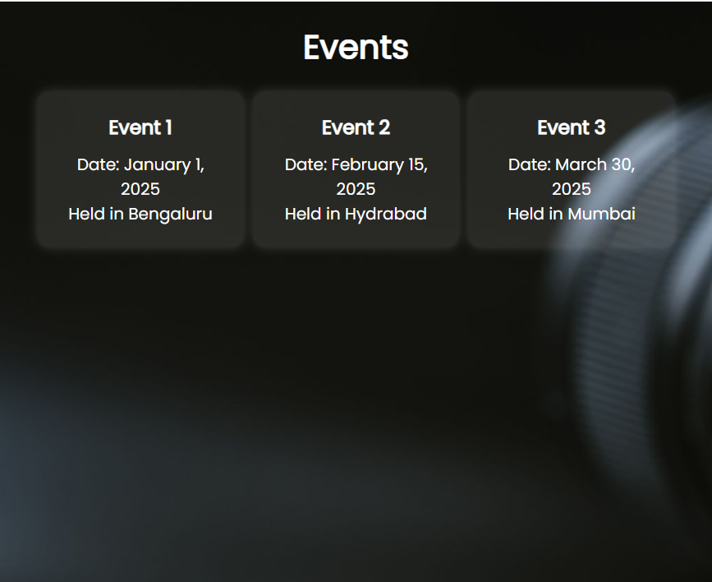
Events
In this option we can see the upcoming events and venue information.
Store
This option redirect you to the store location in google maps
Contact
Event page
In this page you can see the mobile number or other contact information

Slide 7
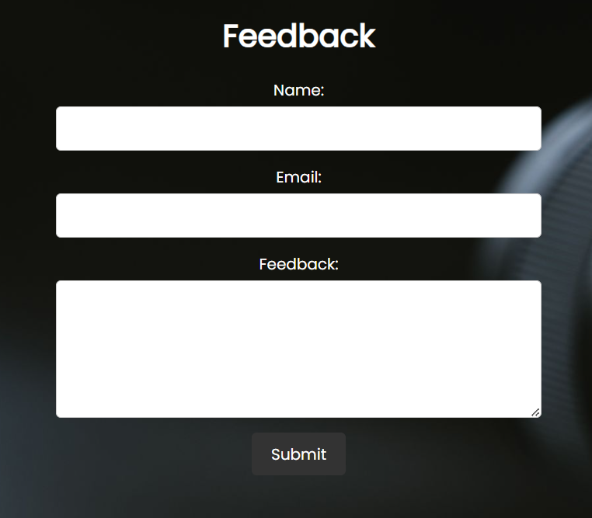
Feedback
In this page you can give feedback of the website or our work
To give feedback here are some steps to follow
1.Fill your name
2.Enter your Email address
3.Give your feedback
4.Click on submit
Feedback form

Slide 8
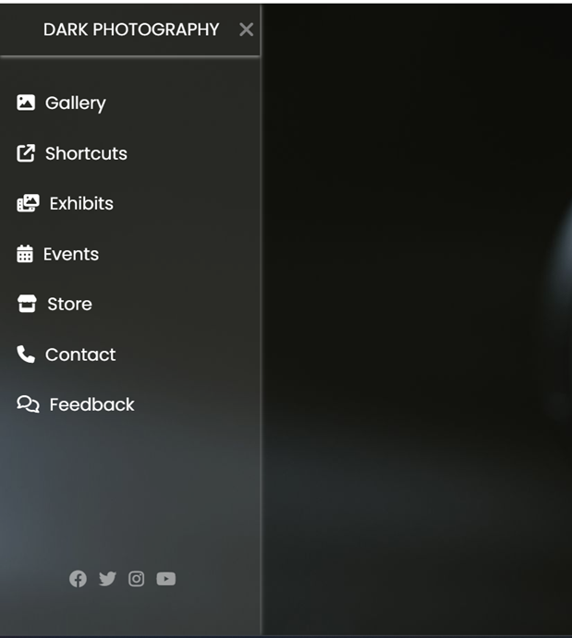
Social media icons
By clicking on icons , you will get into our social media pages or accounts
By hovering on icons opacity of icons increase and size also increases slightly .
Media icon buttons

Slide 9

Updates or features that can be added
Add option for payment and booking
We can make collaboration section to make content with others
Make website more Responsive (by this website can be used in more devices)
Add achievement section to show our achievements

Slide 10

THANK YOU
We hope you enjoyed this presentation

